Slide 1
New and Improved: Modeling Versions to Improve App Recommendation
Date: 2014/10/2
Author: Jovian Lin, Kazunari Sugiyama, Min-Yen Kan,
Tat-Seng Chua
Source: SIGIR’14
Advisor: Jia-Ling Koh
Speaker: Pei-Hao Wu

Slide 2
Outline
Introduction
Method
Experiment
Conclusion

Slide 3
Introduction
Motivation
1. Existing recommender systems usually model items as static—unchanging in attributes, description, and features
2. Mobile apps, a version update may provide substantial changes to an app as updates, may attract a consumer’s interest for a previously unappealing version

Slide 4
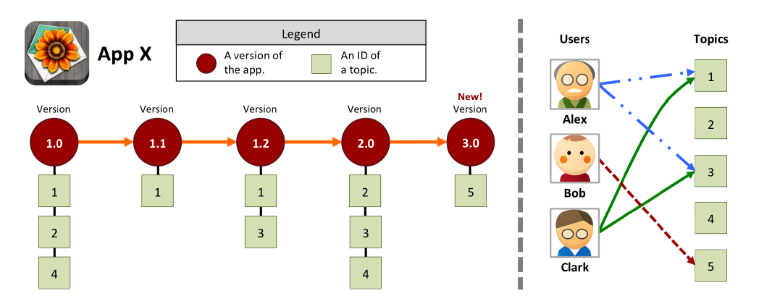
Introduction
Example

Slide 5
Introduction
Latent topic
Important latent topic in genre
Version features
Semi-supervised topic model
Identifying Important Latent Topics
User Personalization
Calculation of the Version-snippet Score
User preference
Score(d, u)
Recommend App

Slide 6
Outline
Introduction
Method
Experiment
Conclusion

Slide 7
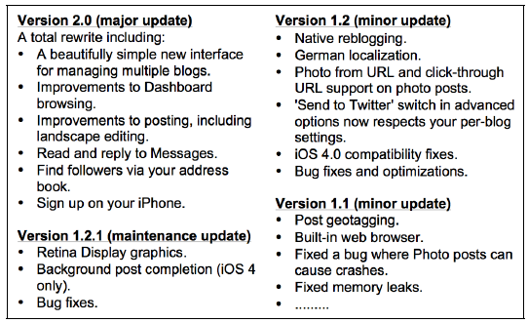
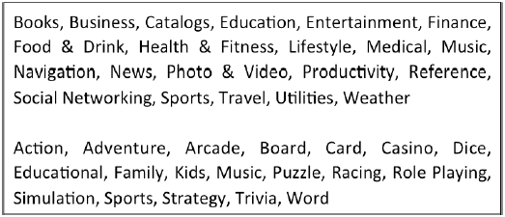
Version Features
Version-categories
Major
Minor
Maintenance
Version-snippet
i.e., app’s changelog
Other information
Genre mixture
Ratings

Slide 8
Semi-supervised topic model
Observed labels
Version categories (i.e., major, minor, maintenance)
Genre mixture (e.g., Books, Business, Action …)
Corpus-enhancement with Pseudo-terms
Inject pseudo-terms (i.e., Genres + category) into the corpus of version-snippets
It will help in getting topic distributions that are more consistent with the nature of version-snippets
Ex:
Version 1.2.1(maintenance update)
Retina Display graphics.
Background post completion (IOS 4 only)
Bug fixes
#Books_genre, #maintenance_update

Slide 9
Semi-supervised topic model
p(topic1|d1)
p(topic2|d1)
.
.
p(topic1|d3)
p(topic2|d3)
d1:
w1,w2
p(w1|topic1)
p(w1|topic2)
.
.
p(w5|topic1)
p(w5|topic2)
d2:
w3,w4
LDA
Topic model
d3:
w5
p(topic1|d1)
p(topic2|d1)
.
.
p(topic1|d3)
p(topic2|d3)
label1
d1:
w1,w2
p(w1|topic1)
p(w1|topic2)
.
.
p(w5|topic1)
p(w5|topic2)
label1
d2:
w3,w4
LLDA
Topic model
label2
label3
d3:
w5
Label4

Slide 10
Identifying Important Latent Topics
We want to know which topics are more important for recommendation
Each genre works differently to the same type of version update
Ex: HD display support would be more enticing and relevant on a “game” app instead of a music app
Popularity score
It is reflected by the votes it receives
Positive votes: rating 3~5
Negative votes: rating 0~2
Ex:
d1: d2:
Positive votes = 8 Positive votes = 1
Negative votes = 1 Negative votes = 8
$π\left(d1\right)=\frac{8−1}{8+1+1}$ = $\frac{7}{10}$ $π\left(d2\right)=0$

Slide 11
Identifying Important Latent Topics
Using the popularity score to define the importance weight of a genre-topic pair
Ex:
g=game p(topic 1| d1) = 0.5
D(game)={d1, d2} p(topic 1| d2) = 0.4
Z={topic 1, topic 2} p(topic 2| d1) = 0.6
z=topic 1 p(topic 2| d2) = 0.3
g
z
$$π\left(d\right)$$
p(z|d)
APP(d)
[ p(topic 1| d1)*$π\left(d1\right)$+p(topic 1| d2)*$π\left(d2\right) ] /$
{[ p(topic 1| d1)*$π\left(d1\right)$+p(topic 1| d2)*$π\left(d2\right) ]+$[ p(topic 2| d1)*$π\left(d1\right)$+p(topic 2| d2)*$π\left(d2\right) ]\}$
= [0.5*0.7 + 0.4*0] / { [0.5*0.7 + 0.4*0] +[0.6*0.7 + 0.3*0] }
=0.35 / { 0.35 + 0.42 } = 0.45

Slide 12
User Personalization
We need to know each user’s preference with respect to the set of latent topics
Analyzing the topics present in the apps that a user u has previously consumed
Ex:
z=topic 1
Z={topic 1, topic 2}
u=user 1
D(user 1)={d1}
P(topic 1|d1)=0.5
P(topic 2|d1)=0.6
u
z
D(u)
p(z|d)
APP(d)
p(topic 1 | d1) / { [ p(topic 1 | d1) ] +[ p(topic 2 | d 1) ] }
=0.5 / { 0.5 +0.6}
=0.45

Slide 13
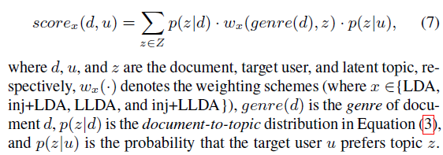
Calculation of the Version-snippet Score
Calculate its score based on its latest version to see if it should be recommend
u
APP(d)
p(z|u)
w(g(d)|z)
z
p(z|d)
Ex:
d=d1
u=user 1
Z={topic 1, topic 2}
genre(d)=game
[ p(topic 1| d1)* w(game, topic 1)*p(topic 1| user 1) ] + [ p(topic 2| d1)* w(game, topic 2)*p(topic 1| user 1) ]
= [ 0.5*0.45*0.45 ] + [0.6*0.4*0.3]
=0.17325

Slide 14
Outline
Introduction
Method
Experiment
Conclusion

Slide 15
Dataset
App Metadata
App ID, title, description, genre
Version Information
All version information of app
Rating
App ID, version number, rating, reviewer’s ID, review comments

Slide 16
Dataset
At least 5 versions, document with at least 10 ratings, users at least rated 20 apps
Dataset consists of 9797 users, 6524 apps, 109338 versions, 1000809 ratings
20% user as target users to receive recommendations
Target users remove 25% of their most recent downloaded apps

Slide 17
Evaluation Metric
Recall@M
Define as :
: The number of apps the user like in the top M
: The total number of apps the user likes

Slide 18
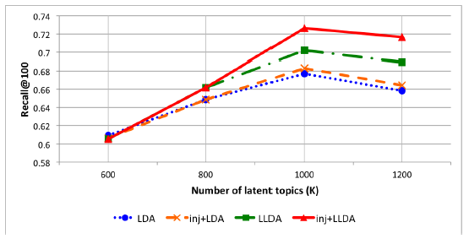
Recommendation Accuracy Obtained by Different Number of Latent Topics
K=1000 gives the best recall scores

Slide 19
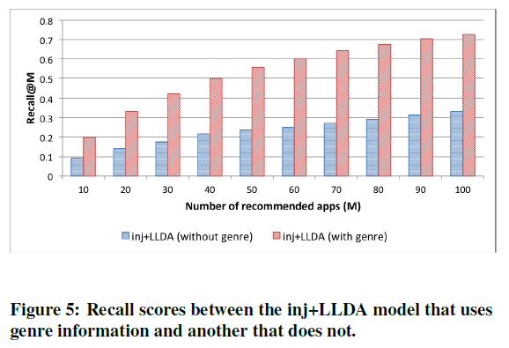
Importance of Genre Information
We compare the recommendation accuracies between models with and without genre information

Slide 20
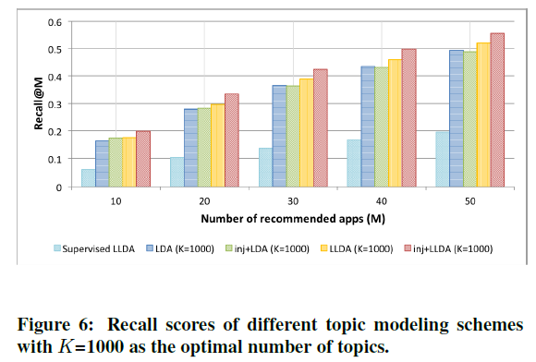
Comparison of Different Topic Models
Enhanced-corpus generally provides better recall
LLDA and inj+LLDA models consistently outperform the pure LDA models

Slide 21
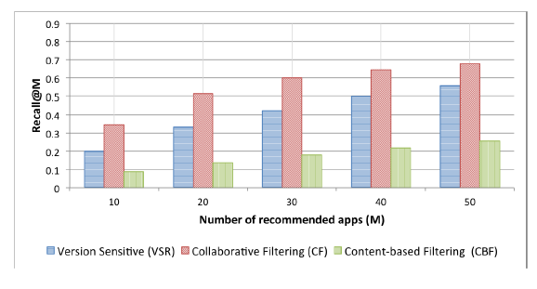
Comparison against Other Recommendation Techniques
VSR underperformed against CF, it does outperform CBF
The textual features in the app descriptions are noisy

Slide 22
Dissecting Specific LDA Topics
We observe that the injected pseudo-terms act as a guide for inj+LLDA’s inferencing process, which contributes to better latent topic generation.

Slide 23
Outline
Introduction
Method
Experiment
Conclusion

Slide 24
Conclusion
Our framework utilizes a semi-supervised variant of LDA that accounts for both text and metadata to characterize version features into a set of latent topics
We used genre information to discriminate the topic distributions and found it is a key factor in discriminating the topic distributions
Our method targets particular versions of apps, allowing previously disfavored apps to be recommended

